Slide 1
Name of Lodge No. ---
ENTERED APPRENTICE DEGREE

Slide 2
ENTERED APPRENTICE DEGREE
FIRST SECTION

Slide 3
ENTERED APPRENTICE DEGREE
SECOND SECTION

Slide 4
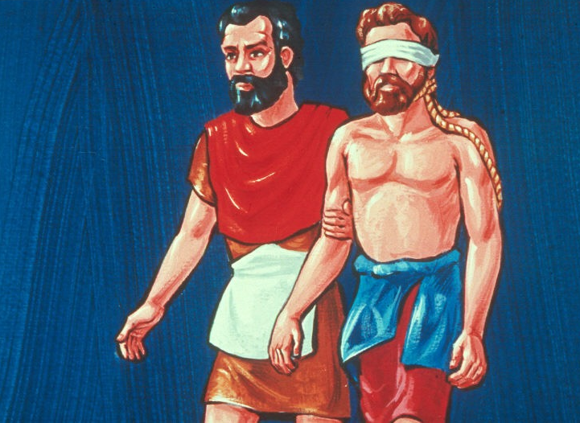

Slide 5
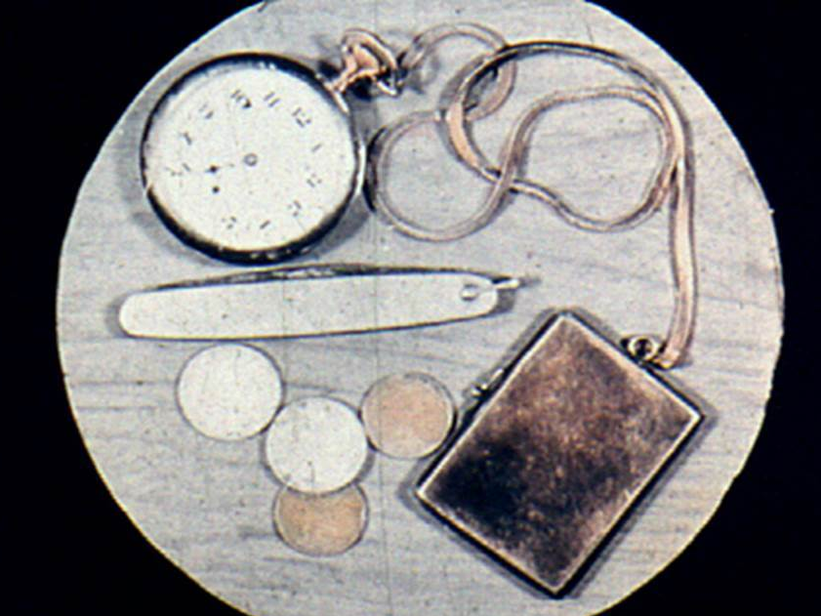

Slide 7
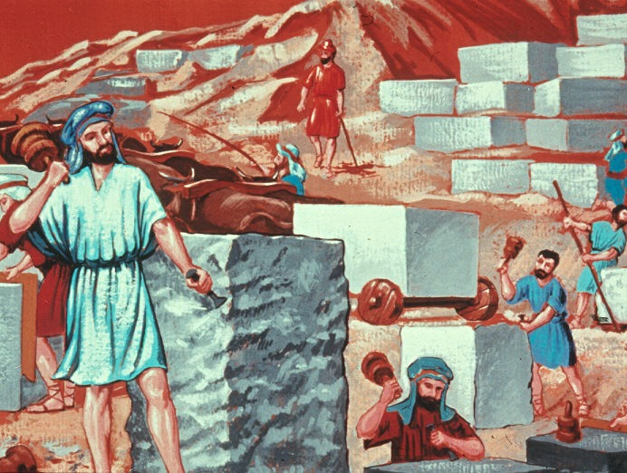

Slide 8
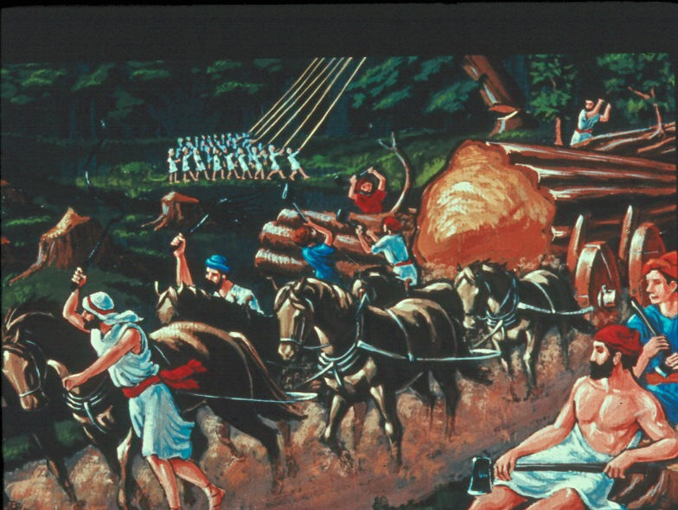

Slide 9
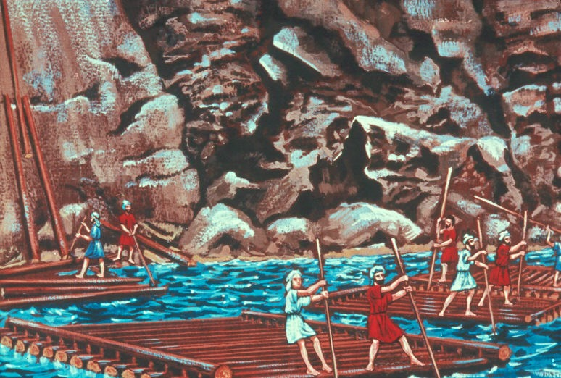

Slide 10
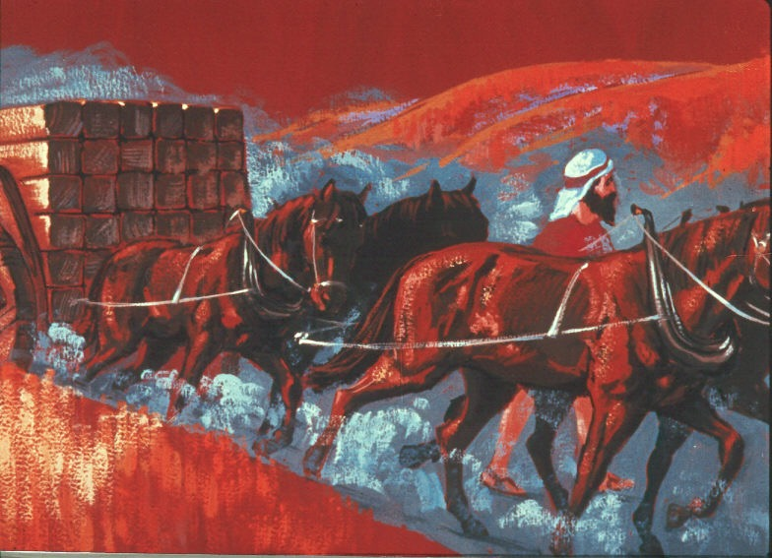

Slide 12
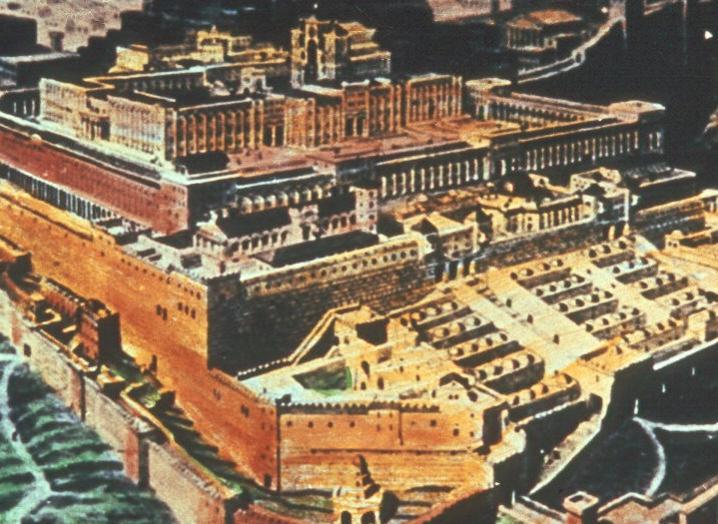

Slide 13
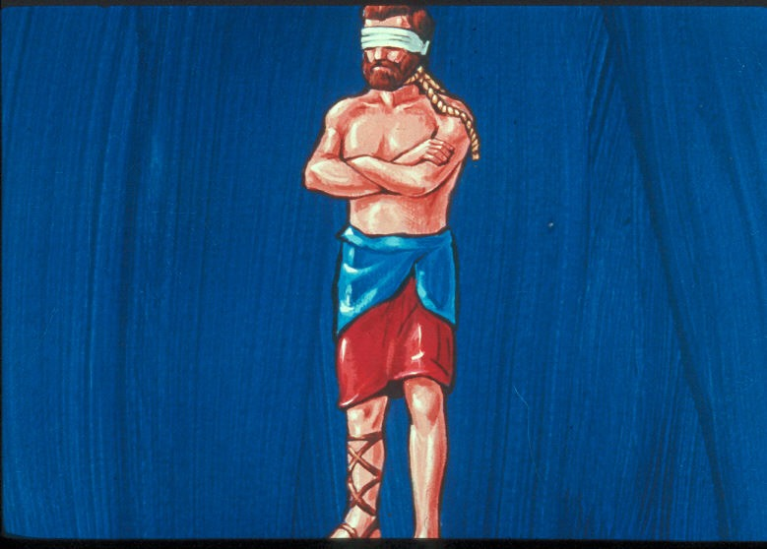

Slide 14
INTERNAL
NOT
EXTERNAL

Slide 16
RUTH 4:7
… to confirm all things;
a man plucked off his shoe,
and gave it to his neighbor…

Slide 20
MATTHEW 7:7
Ask, and it shall be given you;
seek, and ye shall find; knock,
and it shall be opened unto you.

Slide 22
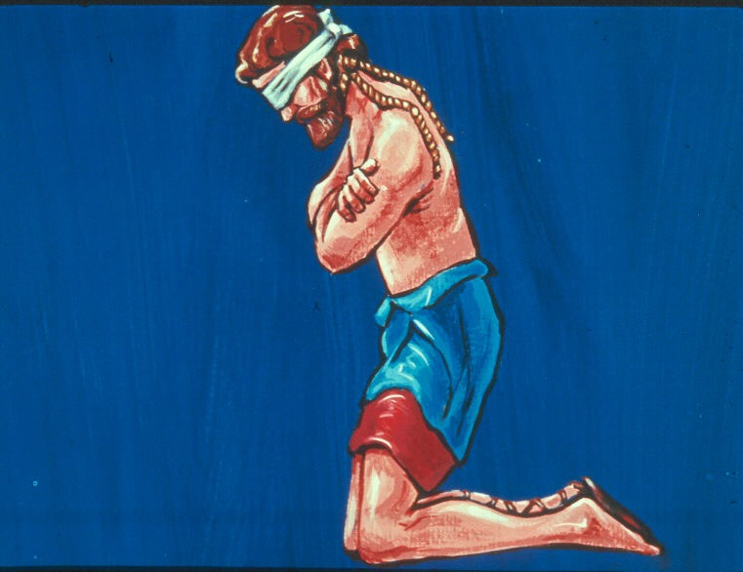

Slide 23
No man should ever engage in any great or important undertaking without first invoking the blessing of Deity.

Slide 26
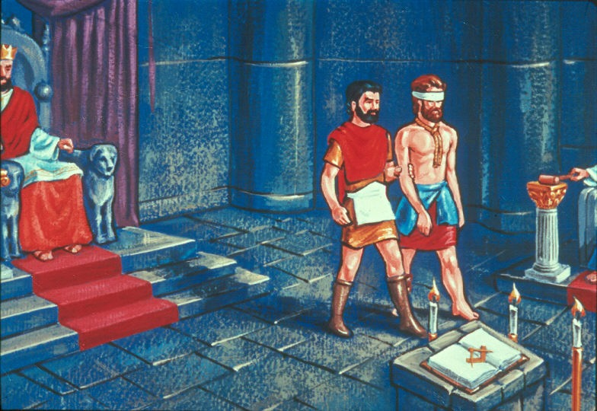

Slide 27
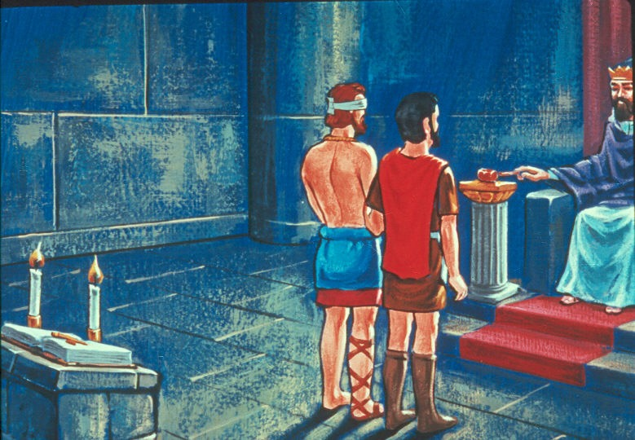

Slide 31
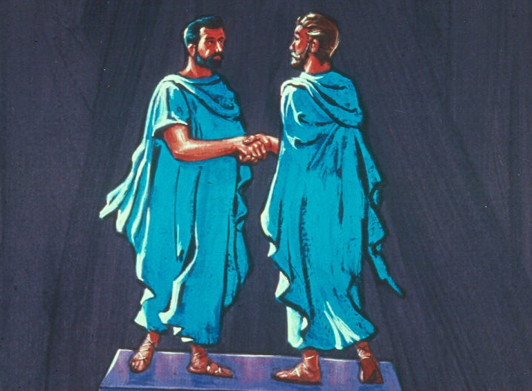

Slide 35
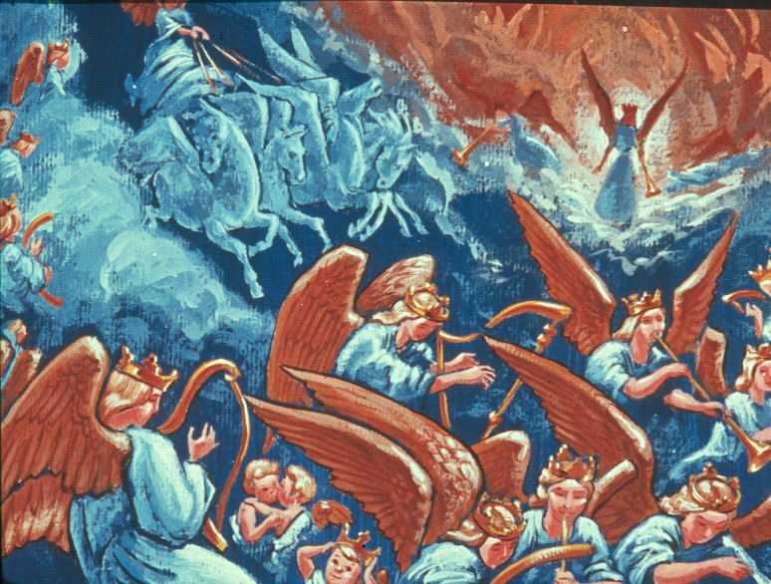

Slide 36
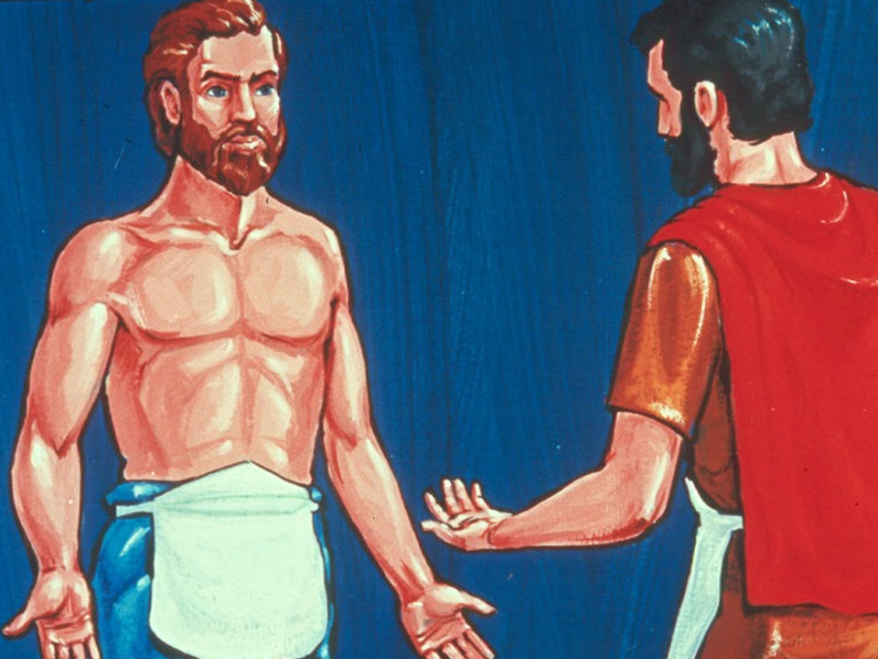

Slide 37
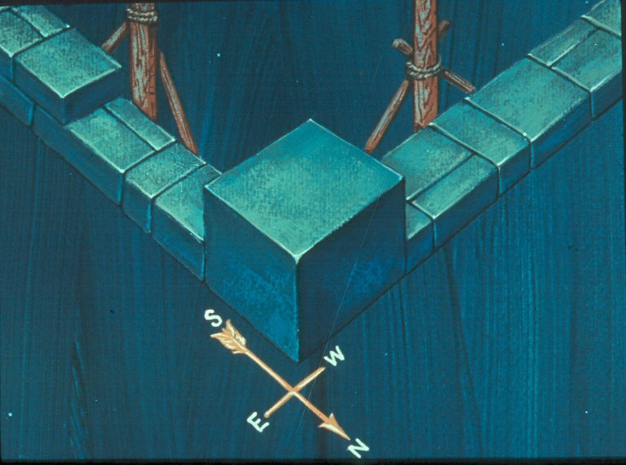

Slide 38
ENTERED APPRENTICE DEGREE
THIRD SECTION

Slide 39
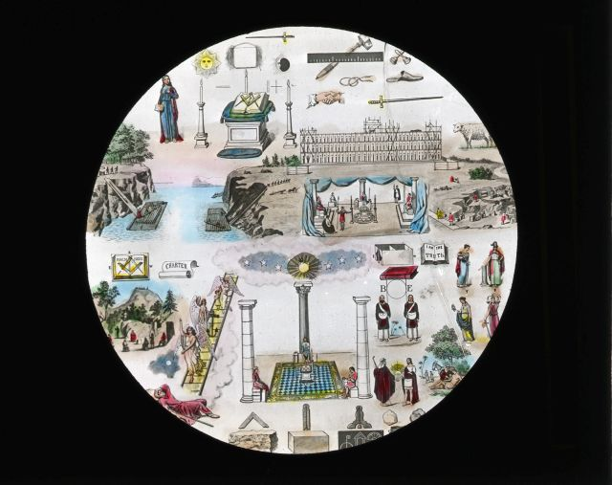

Slide 41
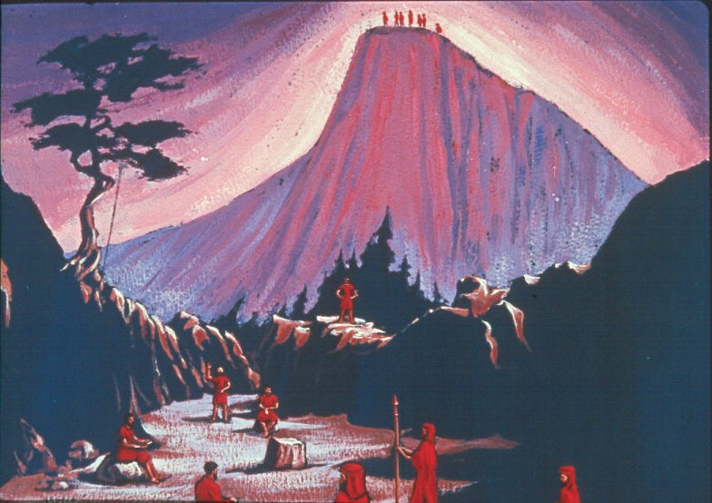

Slide 46
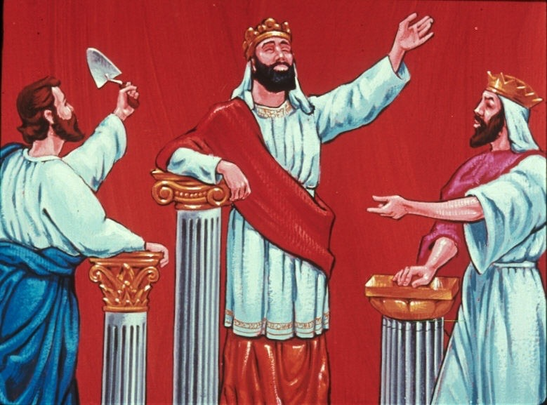
WISDOM
STRENGTH
BEAUTY

Slide 47
Worshipful Master

Slide 48
Senior Warden

Slide 49
Junior Warden

Slide 51
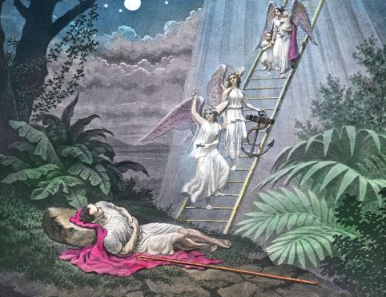

Slide 52
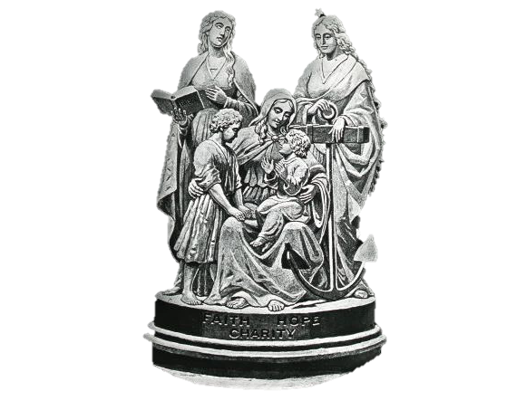

Slide 53
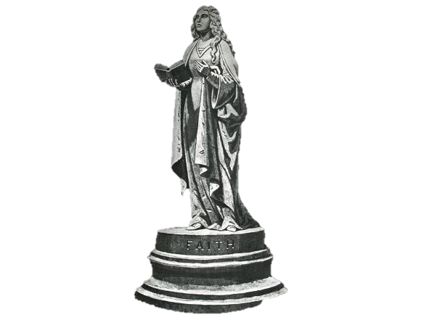

Slide 54
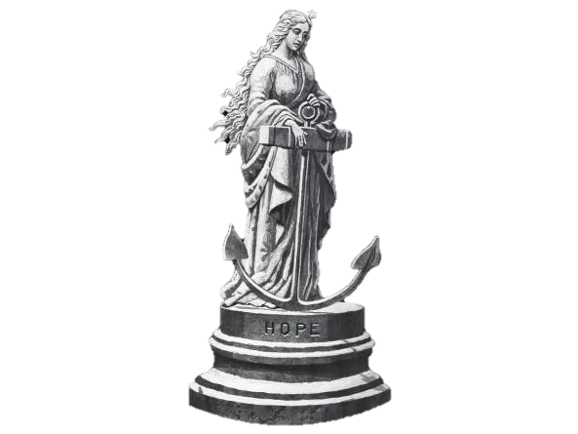

Slide 55
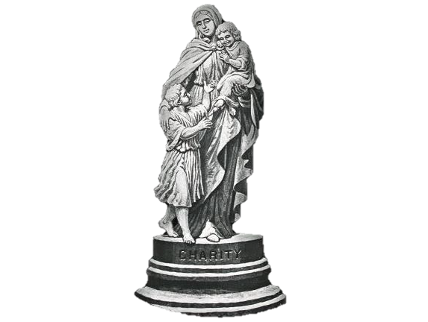

Slide 57
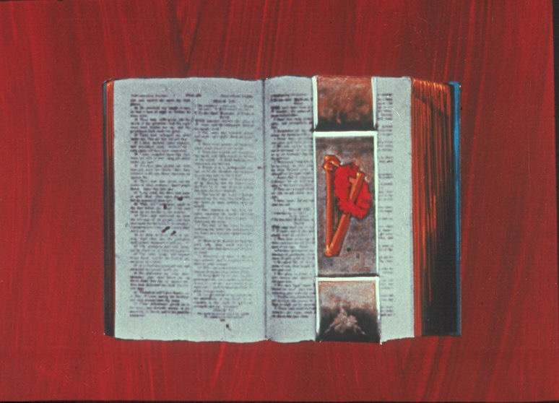

Slide 59
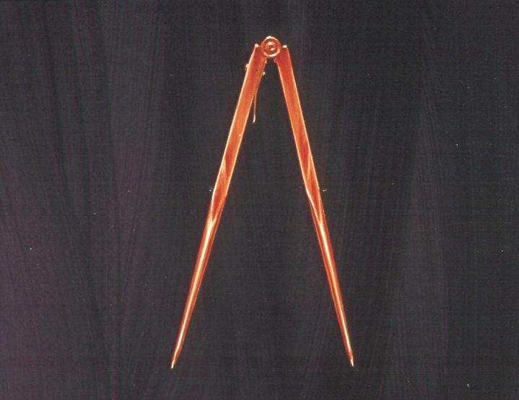

Slide 62
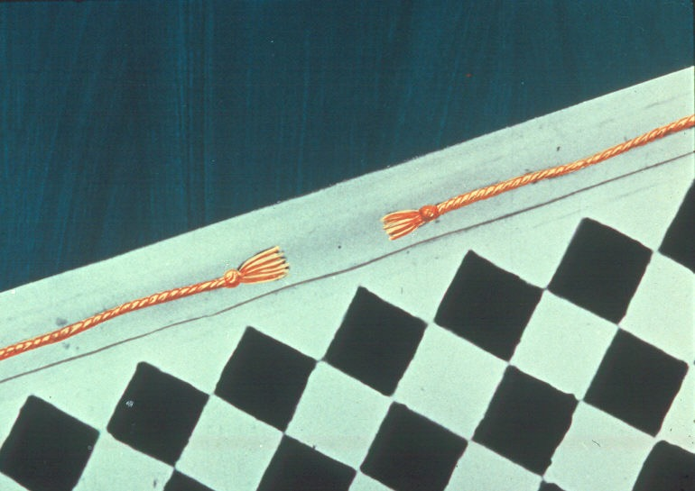

Slide 64
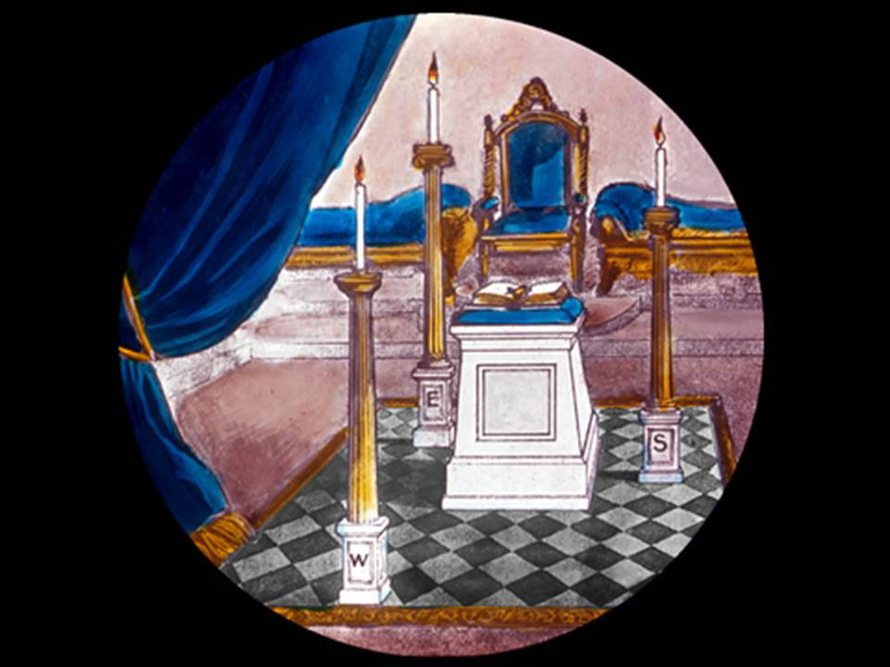

Slide 65
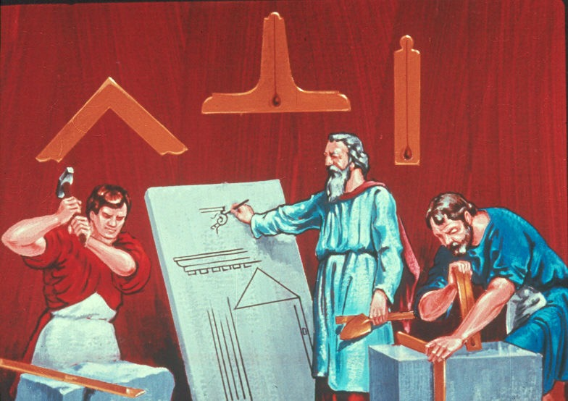

Slide 66
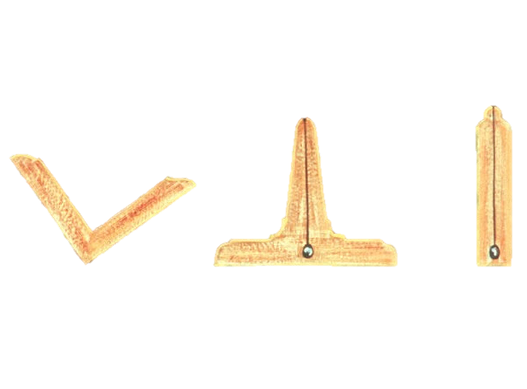

Slide 67
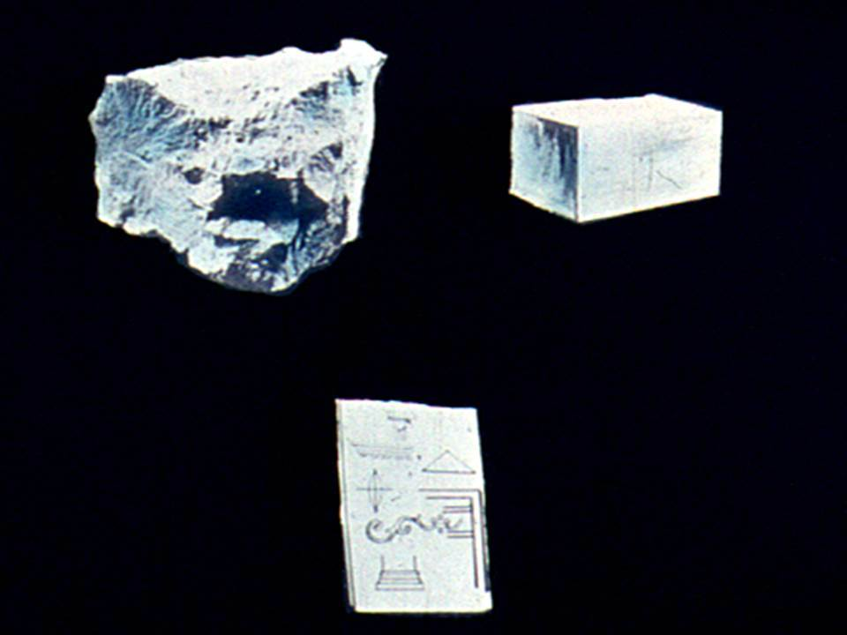

Slide 71
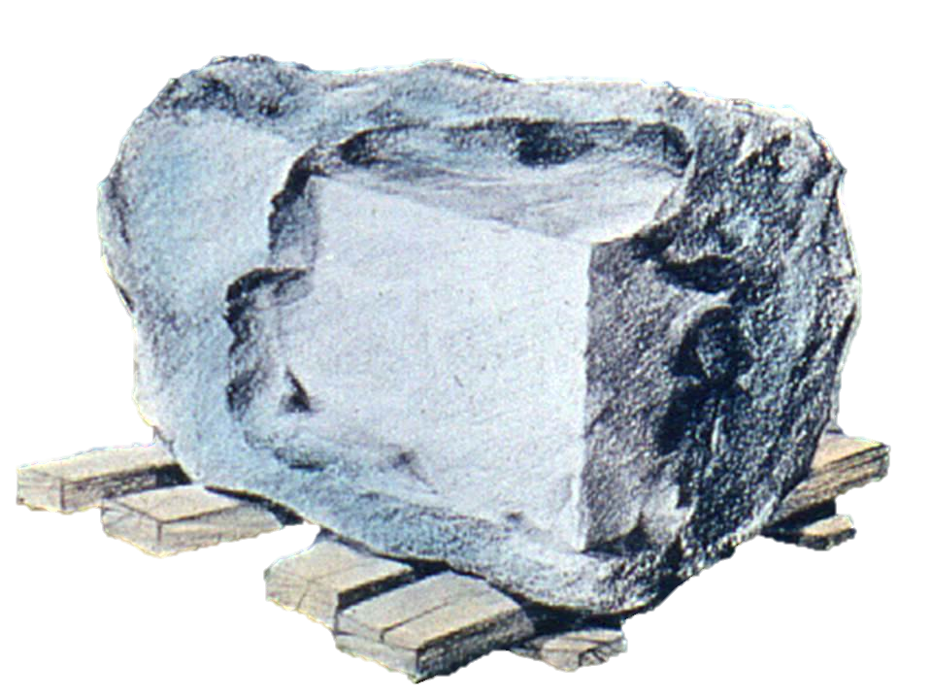

Slide 72
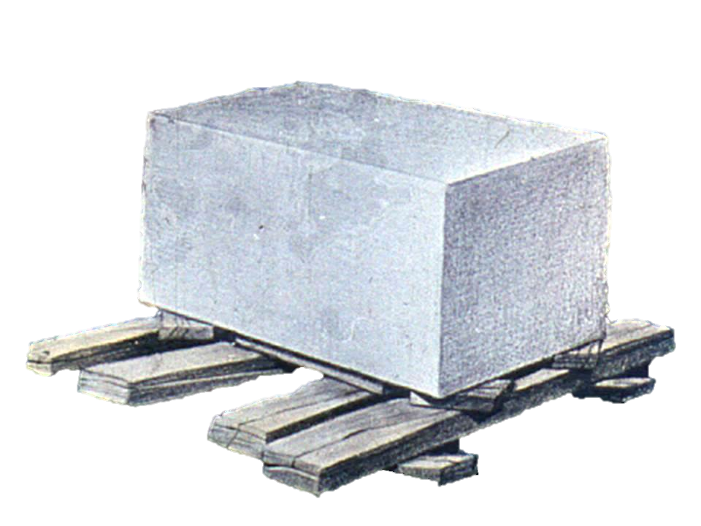

Slide 74
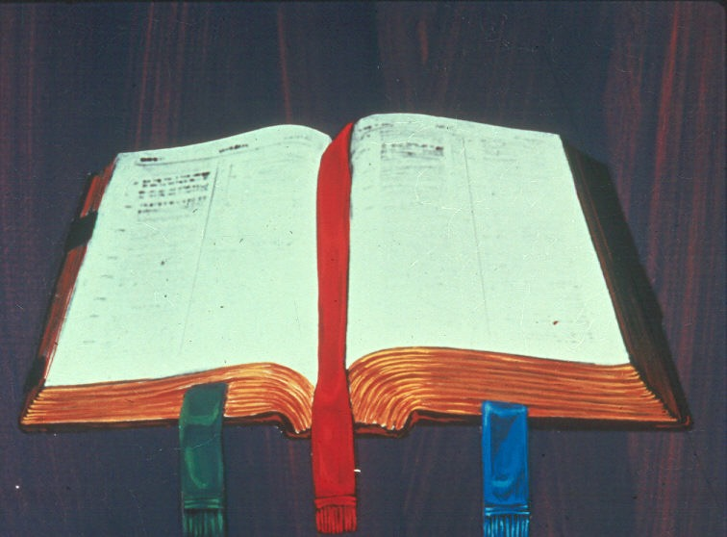

Slide 76
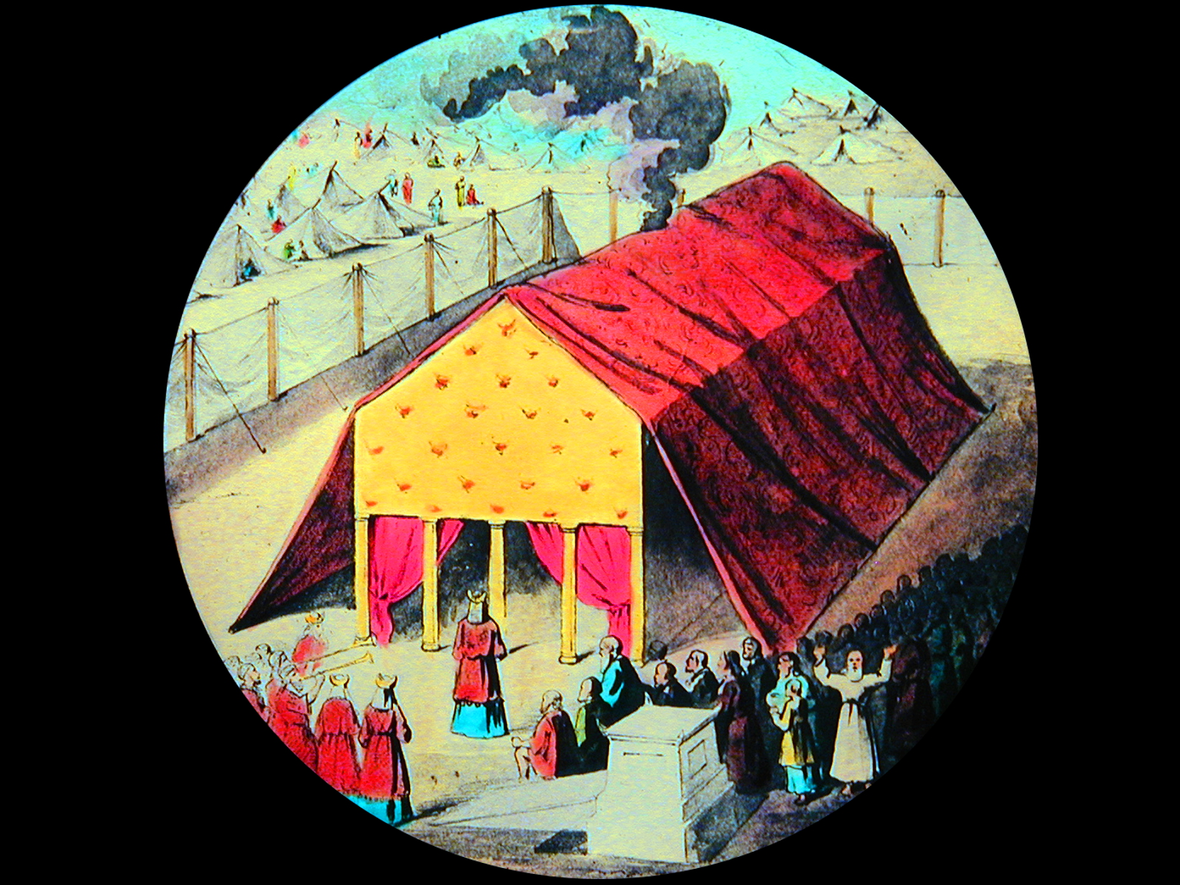

Slide 77
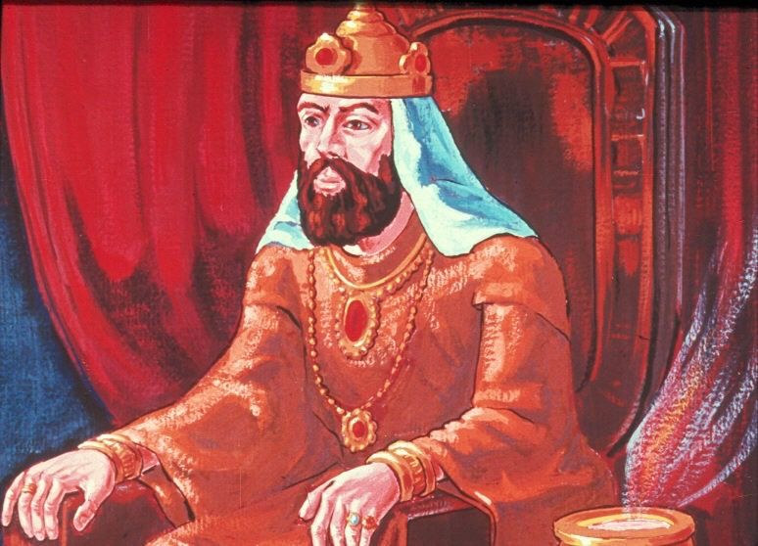

Slide 78
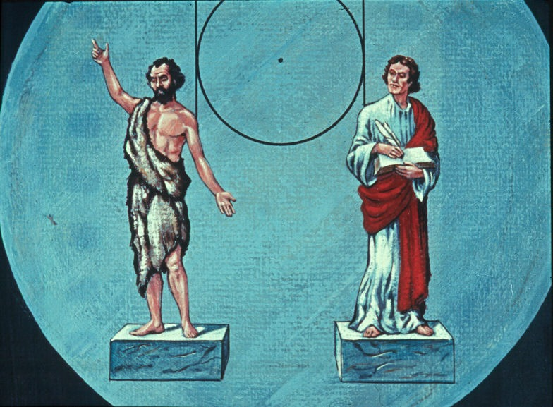

Slide 79
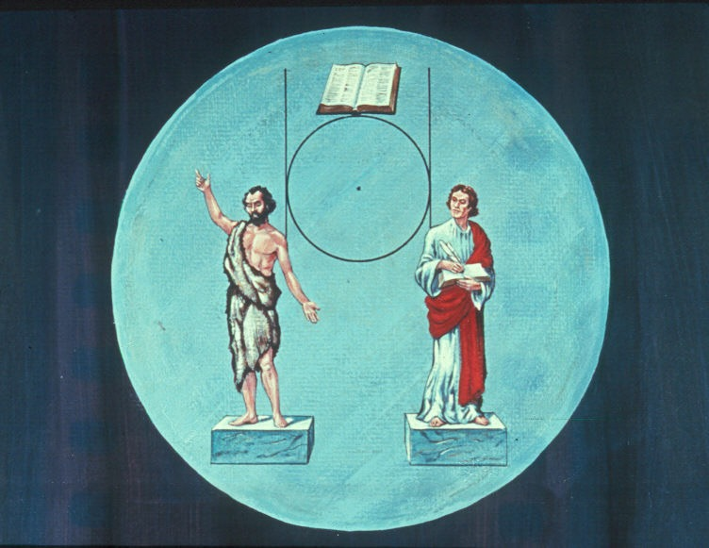

Slide 83
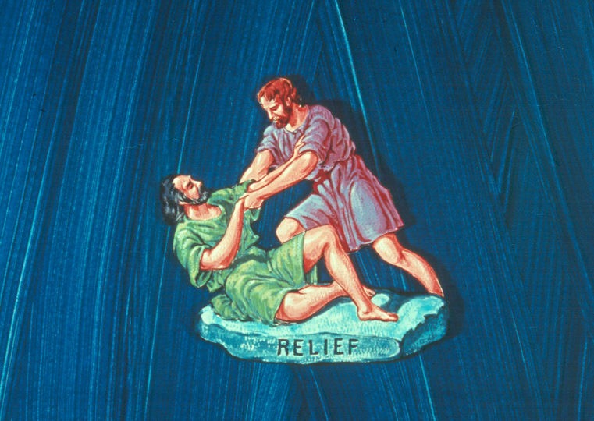

Slide 84
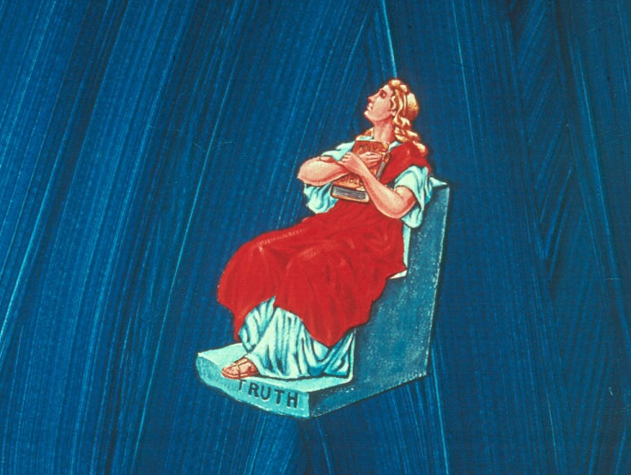

Slide 85
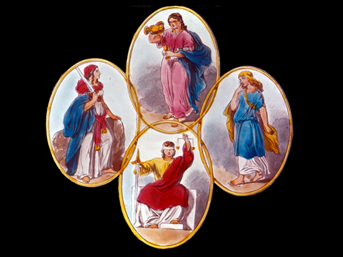

Slide 86
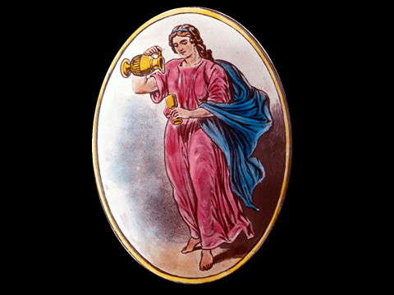
TEMPERANCE

Slide 88
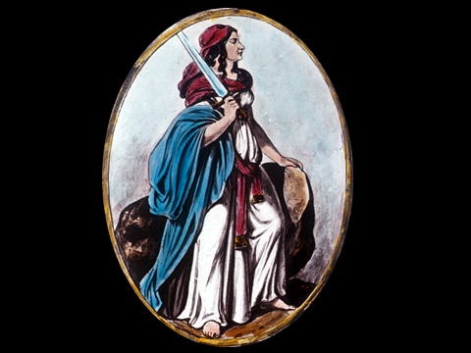
FORTITUDE

Slide 90
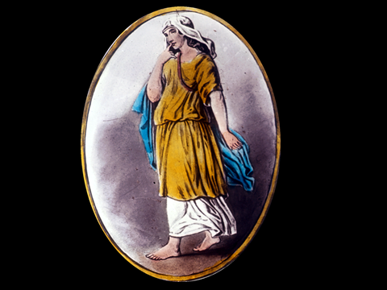
PRUDENCE

Slide 92
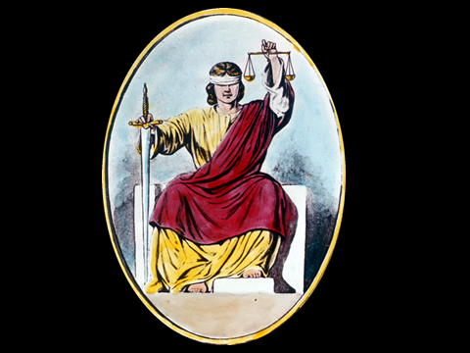
JUSTICE

Slide 100
ENTERED APPRENTICE DEGREE
CHARGE

Slide 101
Name of Lodge No. ---
ENTERED APPRENTICE DEGREE

