Slide 1
ENTERED APPRENTICE

Slide 23
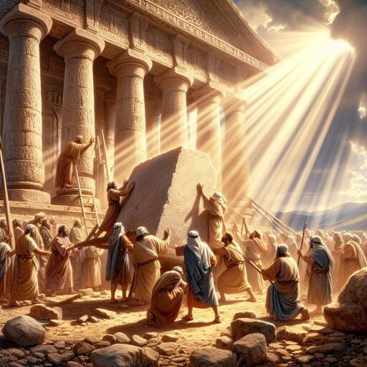

Slide 24
The 3rd Section explains…

